Slide 1
MEASURING EARTHQUAKES
PRESENTED BY
HARSHIT KARTHIKEYAN

Slide 2
Contents
- Ritcher scale
- Seismograph
- Fun facts
- Recap

Slide 3
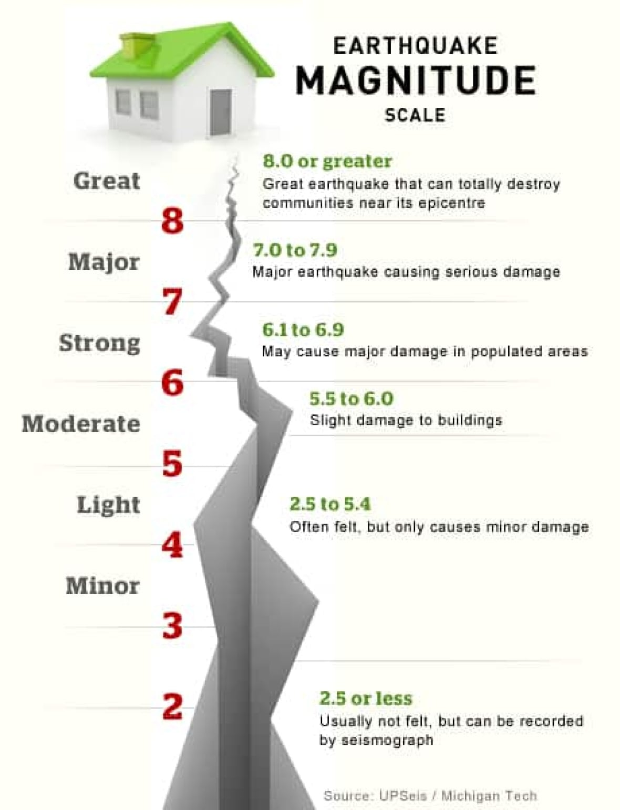
Ritcher scale
The intensity of earthquake waves on the Ritcher scale
The Ritcher scale ranges from 0 to 9
An increase in one point on the Ritcher scale indicates that the force of the earthquakes is 10 times greater than the strength of the previous number.
- The earthquakes of intensity 6 and above are very destructive

Slide 4
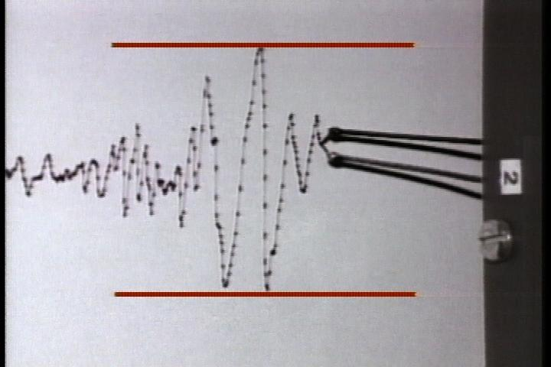
Seismograph
-The earthquake tremors are recorded by an instrument called seismograph
-The science that deals with earthquakes is called seismology
-The scientists that study earthquakes are called
seismologists

Slide 5
Fun facts
-In132AD,a Chinese man named Zhang heng invented the first seismograph
MAGNITUDE 9.5(1960)Biobio,Chile-commonly referred to as the Valdiva earthquake or Great Chilean earthquake, is the largest earthquake in history

Slide 6
Recap
1 The earthquake tremors are recorded in what instrument?

Slide 7
ANSWER:
SEISMOGRAPH

Slide 8
2 What are the numbers in which Ritcher scale ranges to?

Slide 9
ANSWER:
0 to 9

Slide 10
THANK
YOU

